Slide 1
MIKE 11
Bridge Modelling using Bridge Module

Slide 2
BRIDGE MODULE
Recognised Approaches for Estimating Head Loss

Slide 3
BRIDGE MODULE
Defined in the Network File
How? Network File -> View -> Tabular View -> Structures Page
Approaches:
Bridge Piers
Arched Bridges
Submergence
Overtopping

Slide 4
BRIDGE MODULE
Unique Bridge ID Required
Bridge Tab on Structures Page
List of Options
Changes with Method Selected
(Combine as Required)
Overflow Only Available in Combination with Submergence

Slide 5
BRIDGE MODULE
Available Methods
Methods:
Experimentally Based Tables
Free Flow Methods
Orifice Flow
Free flow only
Energy Equation is the Simplest Method for Combined Flow Regimes

Slide 6
BRIDGE MODULE
Arch Bridges (Two Types)
Biery and Delleur:
Calculates Discharge based on Average U/S Water Depth and Arch Geometry
Table relating the Coefficient of Discharge to: - bridge opening ratio (b_{arch}/b_{u/s}) - downstream Froude number
Based on Experiments in Rectangular Channel
Hydraulic Research Method:
Estimates Discharge based on U/S and D/S Water Levels
Table relating the Backwater Ratio to: - blockage ratio (b_{arch}/b_{u/s}) - downstream Froude number
Upstream Cross-Section should be one Bridge Span away

Slide 7
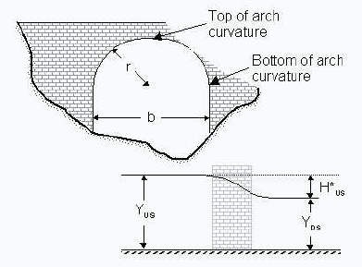
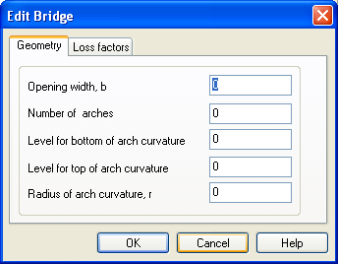
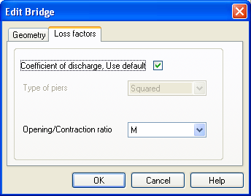
BRIDGE MODULE
Arch Bridges (Geometry and Loss Factors)
Assumes Free Surface (no Submergence)
Submergence and Overtopping can be Added using Other Methods

Slide 8
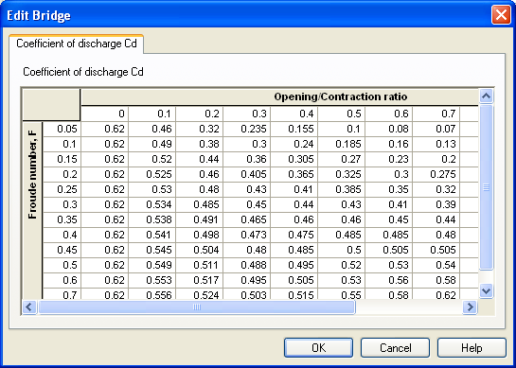
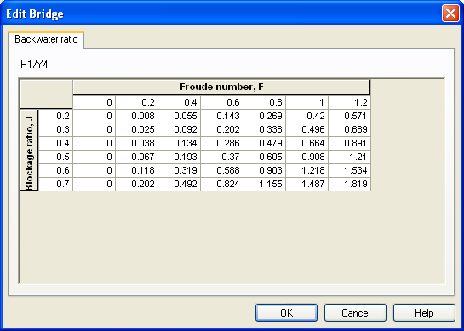
BRIDGE MODULE
Arch Bridges (Default Tables)
Default Table is for a Semi-Circular Arch (no Skew, Eccentricity, Entrance Rounding or Piers)
Biery and Delleur
Hydraulic Research Method

Slide 9
BRIDGE MODULE
Bridge Piers (D’Aubuisson)
Two solutions:
Rectangular Channel if b_{U/S} is positive
Momentum Equation if b_{U/S} is non-positive
Zero Bed Slope assumed, ensure that adjacent Cross-Sections are close to Minimise Errors
Effect of piers neglected when Froude Number > BRIDGE_FROUDE_CRITERIA in MIKE11.INI (Default Value 0.6)
Only Available with Special Module!

Slide 10
BRIDGE MODULE
Bridge Piers (Nagler)
Estimates Discharge based on:
bridge opening width
pier geometry
U/S and D/S water level, depth and velocity
Uses a table relating the Coefficient of Discharge and Adjustment Factors (θ and β) to the Bridge Opening Ratio (b_{arch}/b_{U/S})
Not Accurate for High Velocities

Slide 11
BRIDGE MODULE
Bridge Piers (Yarnel)
Estimates Discharge based on:
bridge opening width
upstream width
pier geometry
downstream Froude number
U/S and D/S water level, depth
Uses a table relating the Pier Shape Coefficient a to the Bridge Opening Ratio (b_{arch}/b_{U/S})
Both Nagler and Yarnell based on Free Flow Experiments

Slide 12
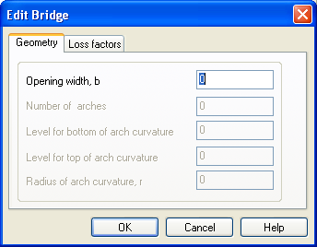
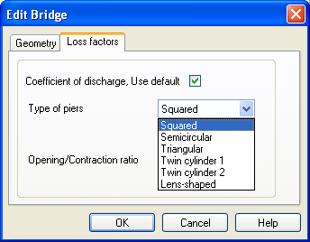
BRIDGE MODULE
Bridge Piers (Geometry and Loss Factors)

Slide 13
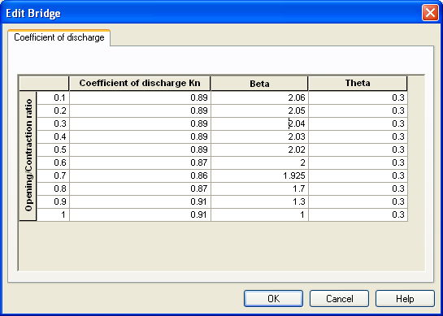
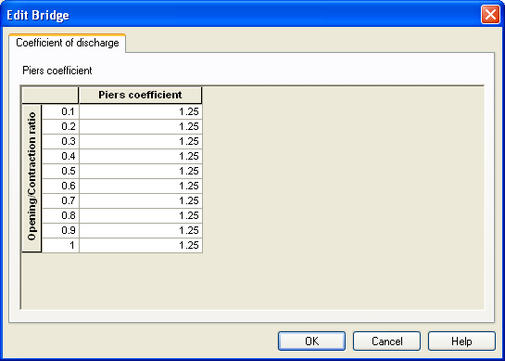
BRIDGE MODULE
Bridge Piers (Default Tables)
Nagler
Yarnell

Slide 14
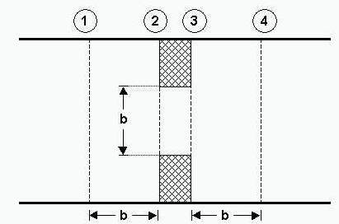
BRIDGE MODULE
Geometric Requirements
USBPR, Energy Equation and FHWA Methods have Shared Geometric Requirements:
Sections [ , ] in the Cross-Section Database Located Approximately b U/S and D/S of the Bridge
Sections [ , ] in the Interface Representing Bridge Geometry at Face with Assigned Bank Markers
1
4
1 – Left Levee Bank
5 – Right Levee Bank
2
3
4 – Toe of L Abutment
5 – Toe of R Abutment
2 – Lowest Point

Slide 15
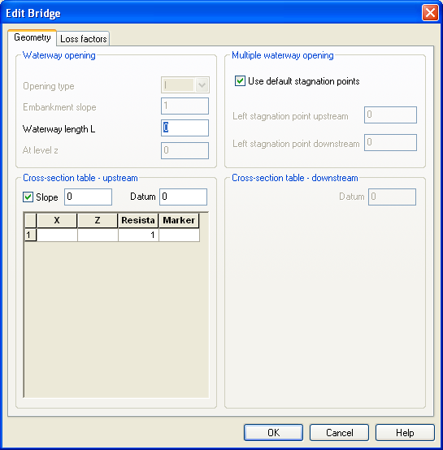
BRIDGE MODULE
USBPR Method
US Bureau of Public Roads Method:
Estimates Free-Surface Flow assuming Normal Depth Conditions
Can be used for Multiple Openings
Uses Loss Factor Tables for: - Base Coefficient (k_{b}) - skewness, eccentricity and piers - velocity distribution coefficient
Based on Experiments

Slide 16
BRIDGE MODULE
Energy Equation Method (Theory)
Energy Equation Method:
Standard Step Method where a Backwater Profile is used to Calculate Bridge Discharge
Accounts for Contraction and Expansion Loss for Arbitrary Shapes, Multiple Openings, Friction and Piers
Assumes Sub-Critical Flow and may switch to Critical Flow for Steep Water Surface Gradients
1
2
3
4
Solution is Iterative for Convergence

Slide 17
BRIDGE MODULE
Energy Equation Method (Geometry)
No Default Tables
Waterway Length (L) in Direction of Flow
Single Cross-Section can be used to Define both Faces of the Bridge (U/S and D/S)
Different Cross-Section can be used to Define the D/S Face

Slide 18
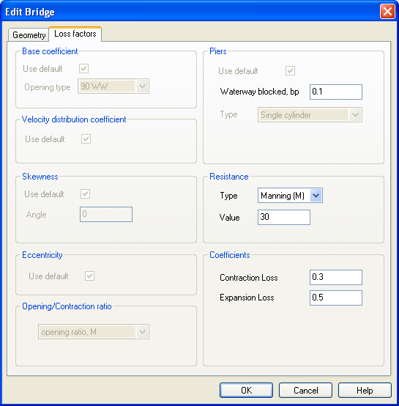
BRIDGE MODULE
Energy Equation Method (Loss Factors)
B
b
bp = (B-b) / B (varies between 0 and 1)

Slide 19
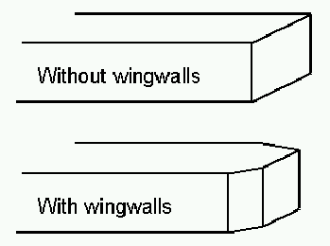
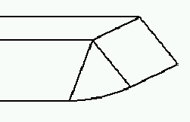
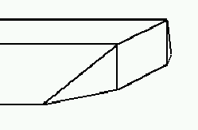
BRIDGE MODULE
FHWA WSPRO Method
Federal Highway Administration WSPRO Method:
Based on the Solution of the Energy Equation
Contraction Loss Accounted for using an Effective Flow Length
Expansion Losses Determined from Experimentally Based Tables
Adjustments (based on Opening Type) for: - abutments, wingwalls, embankments - embankment slope and rounding - eccentricity, skewness and asymmetry - spur dykes and piers/piles
Type I
Type II
Type III
Type IV

Slide 20
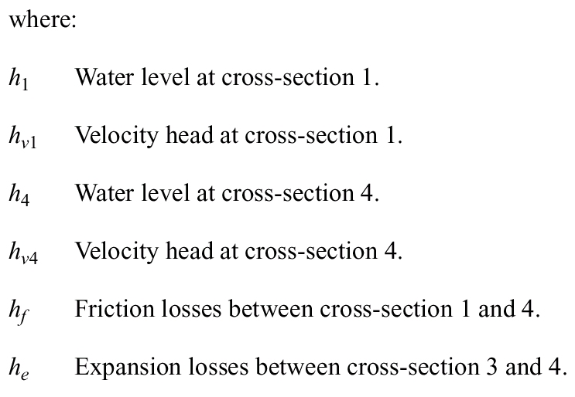
BRIDGE MODULE
FHWA WSPRO Method (Energy Theory)
Total Energy Balance across the Bridge:
1
2
3
4
h_{e} is dependent on the ratio of flow areas and coefficient of discharge

Slide 21
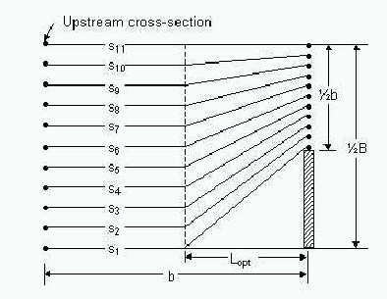
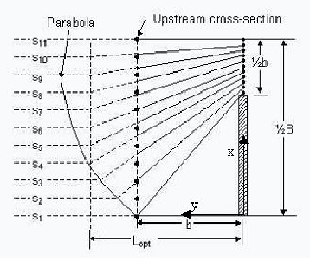
BRIDGE MODULE
FHWA WSPRO Method (Contraction Loss)
Contraction Loss modelled through an Effective Flow Length (Average Streamline Length)
Assumed Streamlines (b > L_{opt})
Assumed Streamlines (b < L_{opt})

Slide 22
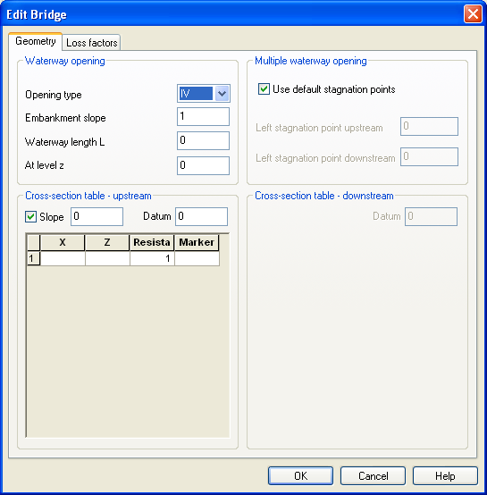
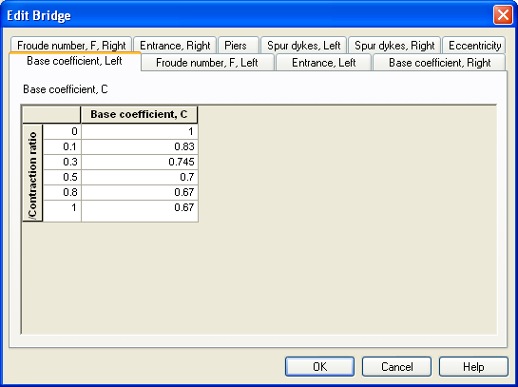
BRIDGE MODULE
FHWA WSPRO ( Geometry and Loss Factors)

Slide 23
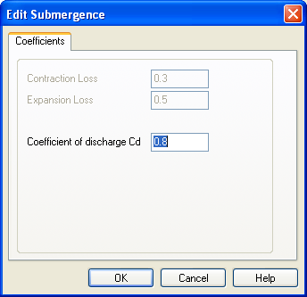
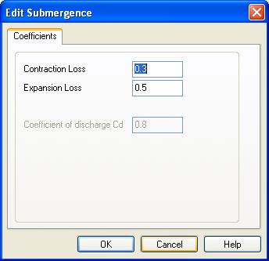
BRIDGE MODULE
Submergence Methods
Flow Contacts the Underside of the Bridge (Soffit), Free Surface Flow cannot Exist and Pressure Flow is Established:
FHWA WSPRO
MIKE 11 Culvert
Energy Equation
Cd for Orifice Flow

Slide 24
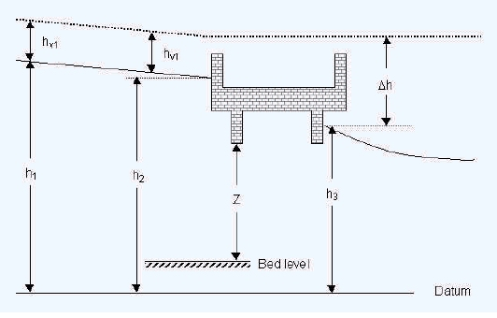
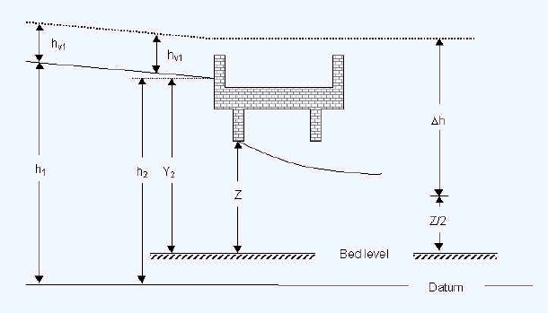
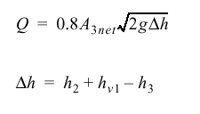
BRIDGE MODULE
FHWA WSPRO Submergence
Submerged Orifice Flow
Orifice Flow

Slide 25
BRIDGE MODULE
Overflow Methods
Three Methods for Overflow:
FHWA WSPRO
MIKE 11 Weir
Energy Equation
Paved or Gravel Surface
Tables of Coefficient of Discharge and Submergence Factors
MIKE 11 Iterates to Ensure that the Energy Loss is the Same for Underflow and Overflow Components

Slide 26
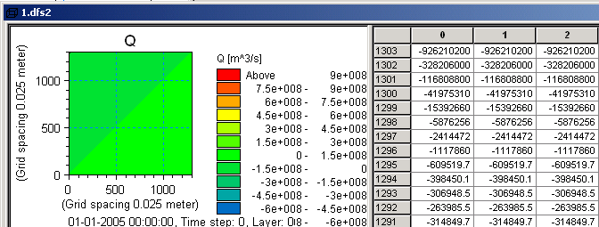
BRIDGE MODULE
Pre-Processed Tables
Bridge Module Pre-Processes Physical Bridge Geometry and Parameters into H-Q-H Tables:
DFS2 (Grid) Format
ASCII Text Format
Both Formats may be Edited and Saved

Slide 27
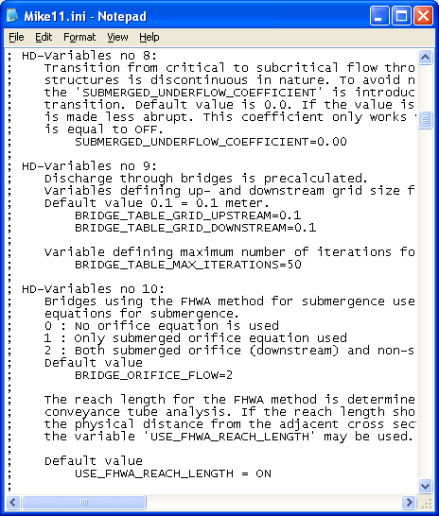
BRIDGE MODULE
Settings in the MIKE11.INI File
ASCII Text File Located at: C:\Program Files\DHI\2011\bin
Contains a Number of Parameters that are used when Modelling Bridges
Copy the MIKE11.ini File to the Same Directory as the SIM11 File to Ensure Changes are for the Current Project Only and not applied Globally

Slide 28
BRIDGE MODULE
Settings in the MIKE11.INI File
HD-Variables Number | Name/Default | Description
8 | SUBMERGED_UNDERFLOW_COEFFICIENT=0.0 | Used to smooth the transition from critical to sub-critical flow through submerged underflow structures
9 | BRIDGE_TABLE_GRID_UPSTREAM=0.1 BRIDGE_TABLE_GRID_DOWNSTREAM=0.1 | Variables defining U/S and D/S grid size for pre-calculated tables (interval of H)
9 | BRIDGE_TABLE_MAX_ITERATIONS=50 | Defines the maximum number of iterations for pre-calculating tables (seldom changed)

Slide 29
BRIDGE MODULE
Settings in the MIKE11.INI File
HD-Variables Number | Name/Default | Description
10 | BRIDGE_ORIFICE_FLOW=2 | 0: Energy equation used for submergence 1: Only the orifice equation is used 2: Both the equations are solved
10 | USE_FHWA_REACH_LENGTH = ON | May be used to impose the physical distance to the U/S section instead of the effective flow length
11 | USE_ALPHA = OFF | OFF assumes uniform velocity distribution, may be used to calculated velocity distribution based on conveyance

Slide 30
BRIDGE MODULE
Settings in the MIKE11.INI File
HD-Variables Number | Name/Default | Description
12 | SMOOTH_BRIDGE_SURFACE = 0 | Filters the the h-Q-h relations: 0 : No filter 1-3 : Filters with different weighting
12 | SMOOTH_BRIDGE_SURFACE_LOOPS = 0 | Number of times the filter is applied to the data (more filtering = smoother)
13 | BRIDGE_PREPROCESSED = OFF | OFF : Tables are generated each run ON : Tables are read from file
13 | BRIDGE_FILE_FORMAT = DFS2 | Select the table format (ASCII or DFS2)

Slide 31
BRIDGE MODULE
Limitations
Limitations of the Bridge Module include:
Bridge deck level can only be defined as flat (no road profile)
Bridge soffit level can only be defined as flat (no inclines)
Blockage Factor (bp) is uniform and not depth dependent
Need to have detailed information on bridge geometry

Slide 32
BRIDGE MODULE
Guidelines for Implementation
Guidelines for Implementing Bridges:
Only include Bridges which are known to Impact on Flow
Use simplest approach possible
Ensure that Bridge & Adjacent Cross-Sections: - are all on same x-axis - are located less than dx-max apart - are about b apart (bridge opening width) - extend above maximum water level
If uncertain, use the default tables of coefficients

Slide 33
BRIDGE MODULE
Guidelines for Implementation
Only include Bridges which are known to Impact on Flow
Use simplest approach possible
Ensure that Bridge & Adjacent Cross-Sections: - are all on same x-axis - are located less than dx-max apart - are about b apart (bridge opening width) - extend above maximum water level
If uncertain, use the default tables of coefficients

